Slide 1
Electrical injuries

Slide 2
Objectives
Identify injuries due to electrocution
Identify circumstances of death
Describe post mortem features of electrocution

Slide 3
Effects of electric current
Effects on the body d/o
1) factors related to the current
2) factors related to the victim

Slide 4

Factors related to the current
voltage
amperage
duration of contact
type of current – AC or DC

Slide 5
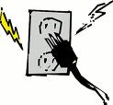
Voltage
Domestic voltage - 230 v
High tension voltage - > 1000 v
Low voltage as 50 v

Slide 6

Amperage
<10 mA - unpleasant sensation
10 mA - lose of muscular control
15 mA - muscular contraction
60 mA - ventricular fibrillation
100 mA - fatal
4 amps - danger decreases

Slide 7

Duration of contact
Greater the contact , more serious effects

Slide 8
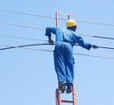
Type of current
AC current is more dangerous than the DC current.

Slide 9
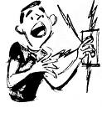
Factors related to the victim
resistance of the body
earthing
point of entry & path taken by the
current

Slide 10
Factors related to the victim
Disease
Ischemic heart disease

Slide 11



Circumstances
Accidental
Domestic
Industrial
Live wires in the environment
Therapeutic accidents

Slide 12

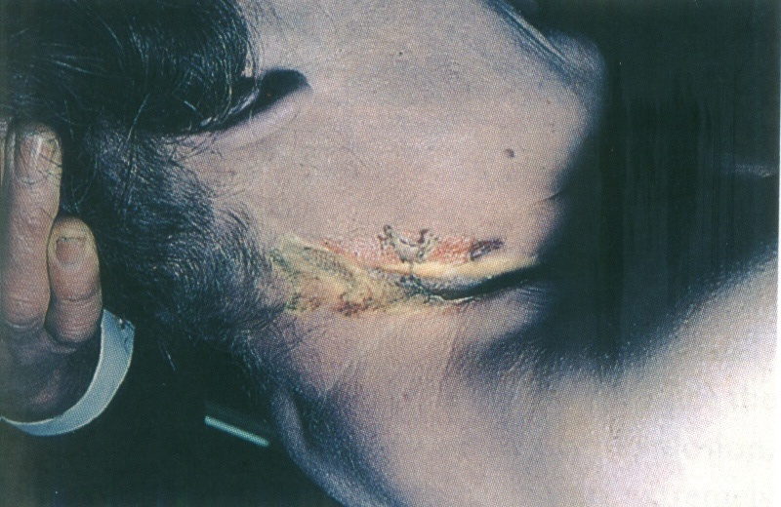
Circumstances cont’.
Suicide
Homicides
Judicial electrocution

Slide 13
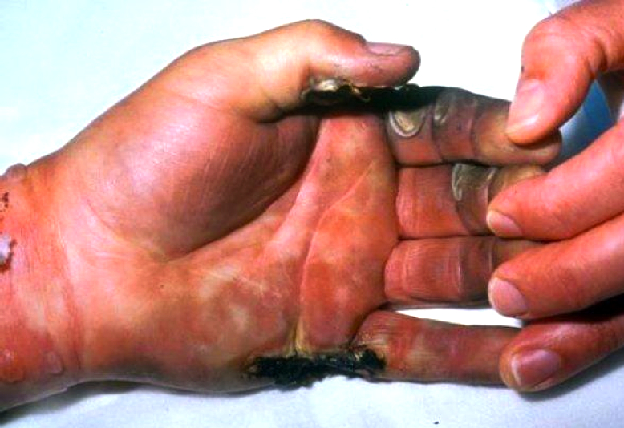
Sings of electrocution
Electrocution produces burns
No marks to charring

Slide 14
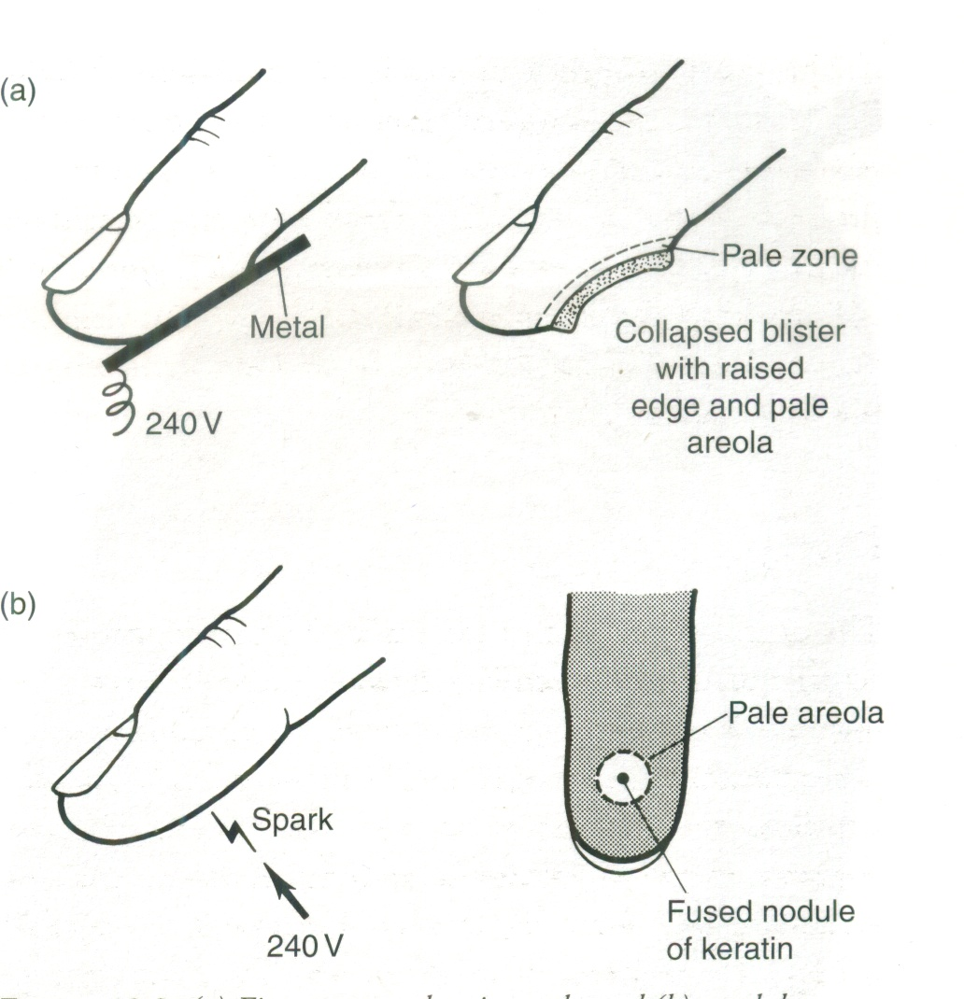
1. Joule burn
found at the point of entry
How does it produce?
Electric energy converted to heat, boiled tissue fluids & the vapour produced blisters.
Blister ruptures & form a crater

Slide 15
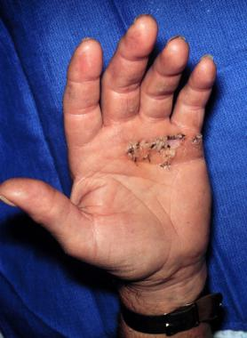
Joule burn con’t.
Features of a Joule burn
Round or oval shallow crater or shape of conductor
Margins are raised
Floor of the crater- pale

Slide 16
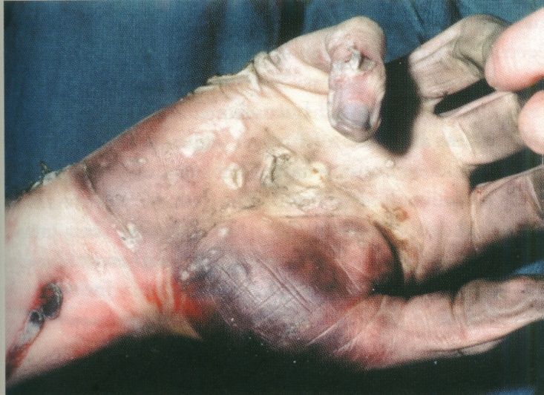
Joule burn con’t.
Features of a Joule burn con’t.
puckering of the surrounded skin
Fluid filled blister
Small pin point burns

Slide 17
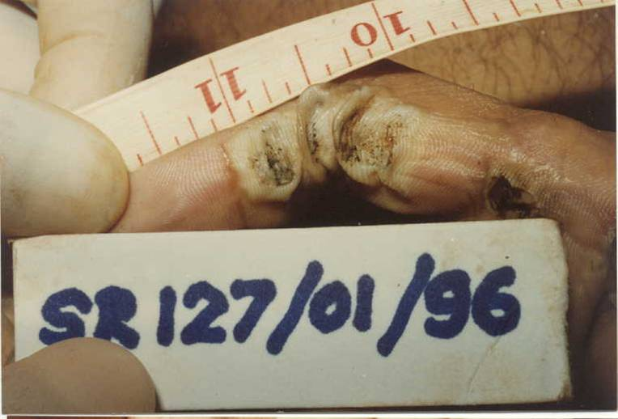

Slide 18

2. Flash burns
Produced in high voltage
multiple burns close to each other
resemble crocodile skin

Slide 19
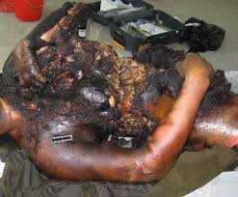
3. High voltage burns
Features of high voltage electrocution
clothing can ignite
extensive burns
charring of the body
thrown away causing injuries

Slide 20
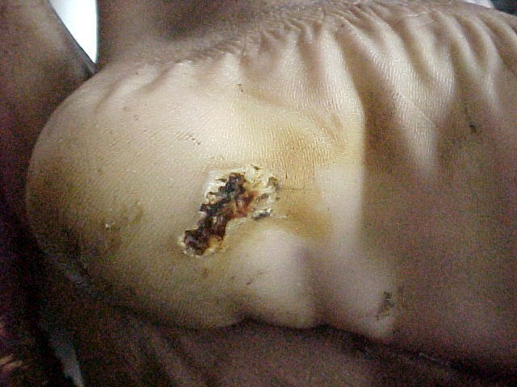
4. Exit marks
Usually on the soles of the feet
often seen as linear splits

Slide 21
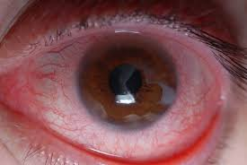
5. Arc eye
There is singeing of the eye lashes, red eye & burns on
the face.

Slide 22
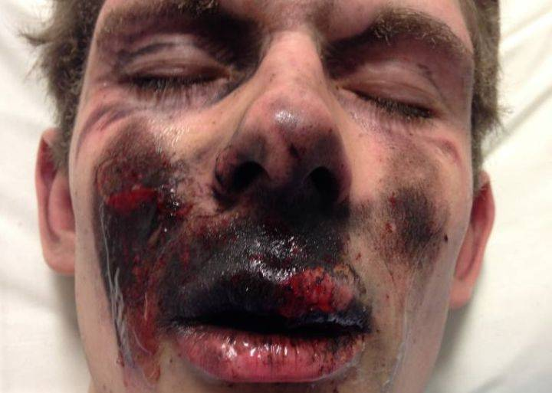
6. Metallization
The face of the victim becomes darkened due to the metallization of the metal particles which are driven into the skin.

Slide 23
Medico-legal examination of death due to electrocution
History
Visit to the scene
Identification
Examination of clothes

Slide 24
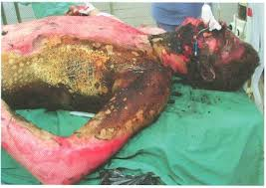
Post mortem appearances
External
Entry & exit burns
crocodile skin burns
extensive burns with charring

Slide 25
Post mortem appearances
External
Arc eye metallic hue over the face
Injuries due to falls
External sings of asphyxia

Slide 26
Post mortem appearances
Internal
Non specific
Sings of asphyxia
Negative autopsy

Slide 27
Investigation
Histological appearance
cells of the epidermis elongated & arranged in parallel rows at right angle to the dermis.
vacuole formation
small haemorrhages

Slide 28
Death due to electrocution
Electricity must travel through a vital organ to cause death.
Current enters at one point and then leaves the body at an exit point.
Pathway depends relative resistance
Take the shortest route between entry and best exit.

Slide 29
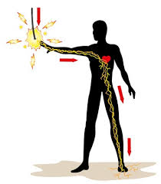
The death is caused by 3 major ways
Passage of current across heart -
Passage of current across the chest and abdomen
Passage of current across head and neck

Slide 30
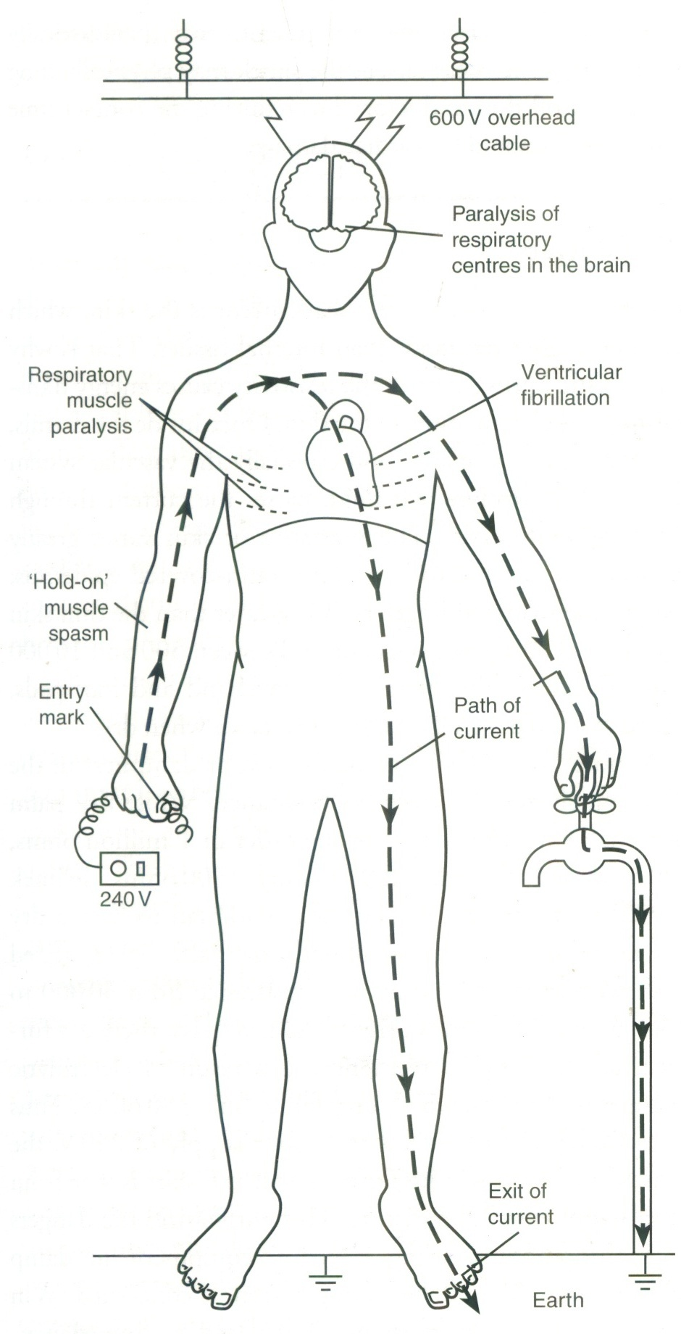
Death due to electrocution

Slide 31
Causes of death
Ventricular fibrillation
Respiratory failure
Mechanical asphyxia
Current passes through the head,
paralysis of the conducting pathway

Slide 32
Causes of death
Burns - high voltage burns
Injuries - fallen from height
Delayed death due to burns &
septicemia

Slide 33
Lightening

Slide 34
Objectives
Identify injuries due to lightning
Describe post mortem features of lighting

Slide 35
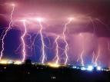
Lightning stroke
Lightning stroke occurs from cloud to the earth through the nearest &
tallest object

Slide 36

Components liberated in lightning stroke
A massive current
Flash – fire effect
Blast effect

Slide 37

Circumstances
Sheltering under the tree
Walking in the open space under umbrellas
Inside a house using telephones, electrical appliances

Slide 38

Effects of lightning
High voltage current causes an immediate cardiopulmonary arrest

Slide 39
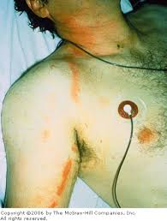
Burns due to lightening
Heated metallic object worn by the person
Superficial linear fern like skin burns over the moist skin creases- Filigree burns

Slide 40
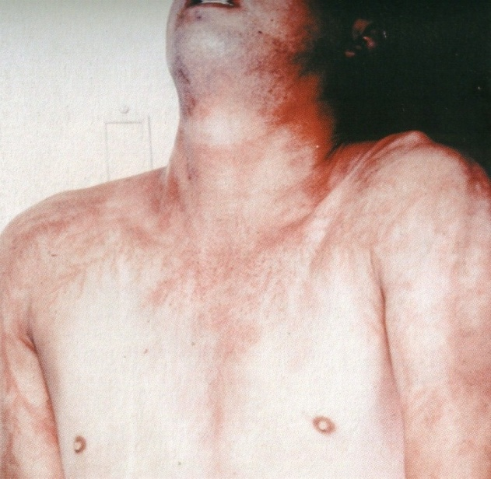
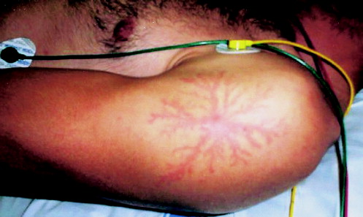
Burns due to lightning
Arborescent burns
Superficial burns alone blood vessels due to local erythema called ferning.

Slide 41
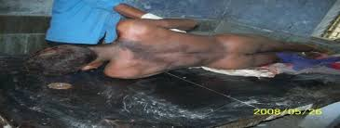
Burns due to lightning
Ignite cloths
Charring of the body

Slide 42
Effects of blast wave in lightning
Tearing of clothing and foot wear
Thrown away injuries, fractures, internal injuries
Damage to lungs, intestine, eardrum due to compression and decompression

Slide 43


Diagnosis of death from lightning
History
History of thunder storm
Evidence of lightning
Dead animals, damage trees and houses

Slide 44
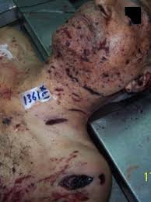
Diagnosis of death from lightning
Melted or magnetized metallic objects
Clothes burnt or torn
Extensive injuries
Typical Burns

Slide 45
Postmortem findings
Internal
Non specific
Congestion of organs
Petechial haemorrhages

Slide 46
Causes of death
Ventricular fibrillation
Burns
Injuries
Delayed effects of burns and injuries

Slide 47
Summery
Signs of electrocution
Joule burn
Arc eye
Exit mark
Metallization

Slide 48
Summery
Component of lightning flash
Current
Flash-fire effect
Blast effect
Effects of lightning
Burns
Blast injuries
Diagnosis of death due to lightning

Slide 49
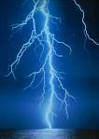
THANK YOU
Thank you

